Slide 1
UNIT 5
SENSORY AND IMMUNESYSTEM

Slide 2
Cell signalling

Slide 3
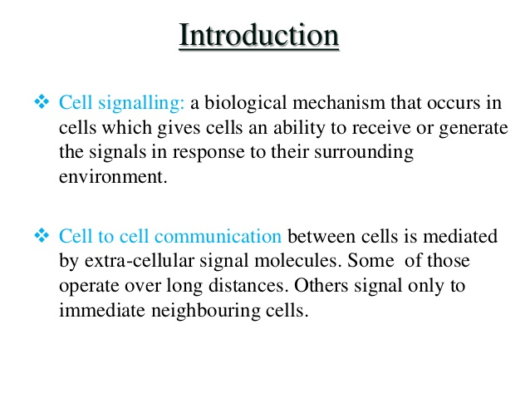
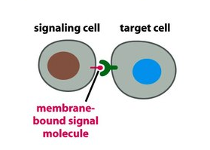

Slide 4
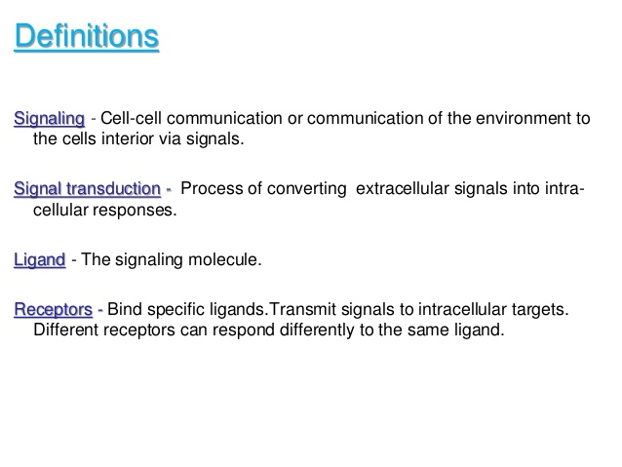
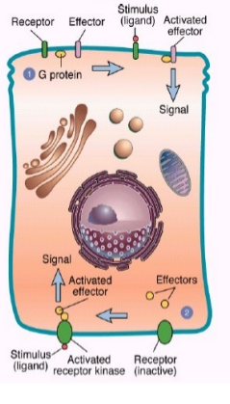

Slide 5
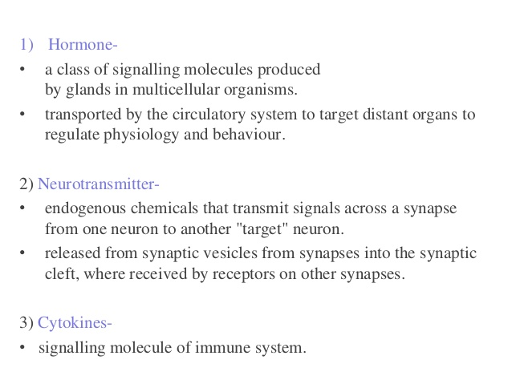
Types of signalling molecules

Slide 6
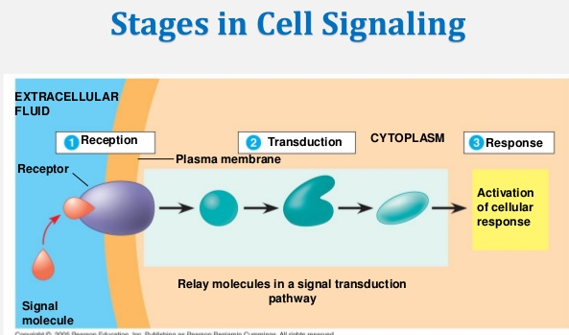
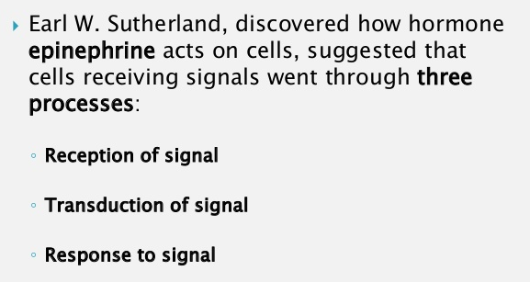

Slide 7
STAGES OF CELL SIGNALING
Reception: In this stage the signal molecule is detected by the receptor protein of target cell. The signal molecule generally comes from outside and is new to the target cell, where as the receptor molecules/proteins are located outside/ inside to the target cell. In other terms reception can be defined as the target cell detection of signal molecule that is coming from outside of the cell.
Transduction: This is second stage of cell signaling where the binding of signal molecule triggers the receptor protein of the target cell initiating the process of transduction.
Response: It is the third stage of cell signaling where the transduced signal finally triggers a specific cellular response. This response may be in the form of cellular activity–such as catalysis by an enzyme (Eg: Glycogen phosphorylase), rearrangement of the cytoskeleton, or activation of specific genes in the nucleus.

Slide 8
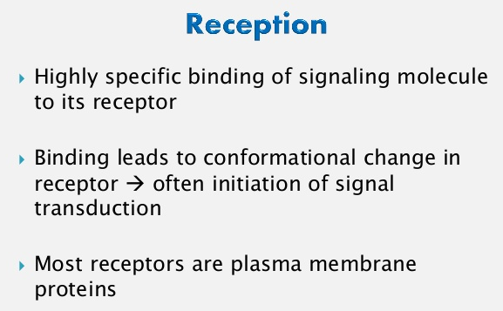

Slide 9
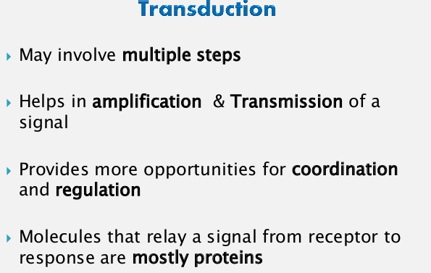

Slide 10
Cellular response (response to signal)
Movement of cytoskeleton
Activation of specific gene in nucleus
anabolic and catabolic rearrangement of molecules etc .,

Slide 11
Types of Cell Signaling Molecules
Signaling molecules are currently assigned one of five classifications.
Intracrine ligands are produced by the target cell. Then, they bind to a receptor within the cell.
Autocrine ligands are distinct in that they function internally and on other target cells (ex. Immune cells).
Juxtacrine ligands target adjacent cells (often called “contact-dependent” signaling).
Paracrine ligands target cells only in the vicinity of the original emitting cell (ex. Neurotransmitters).
Lastly, Endocrine cells produce hormones that have the important task of targeting distant cells and often travel through our circulatory system.

Slide 12
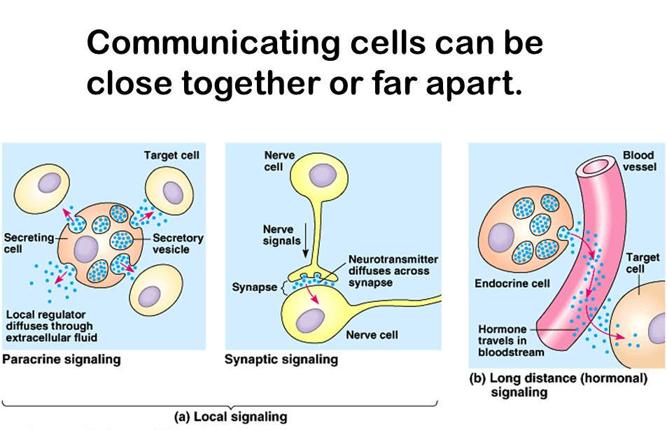
TYPES OF CELL SIGNALLING

Slide 13
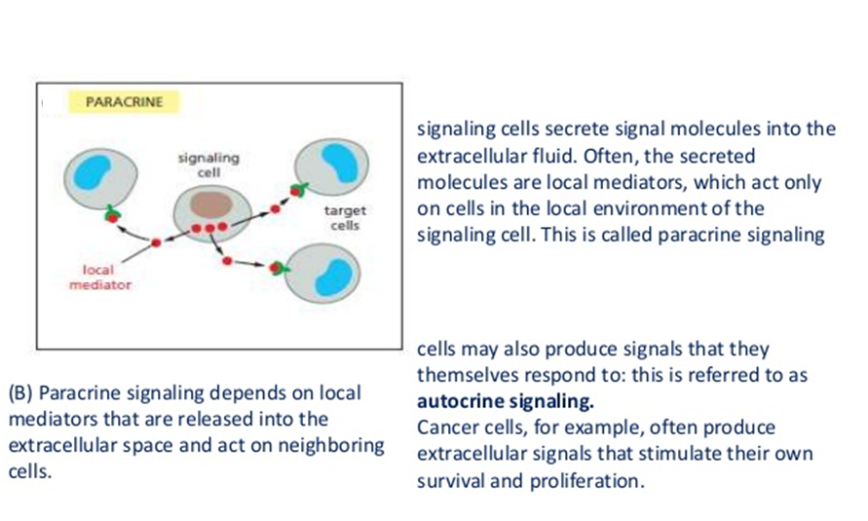
TYPES OF CELL SIGNALLING………
a) PARACRINE CELL SIGNALLING

Slide 14
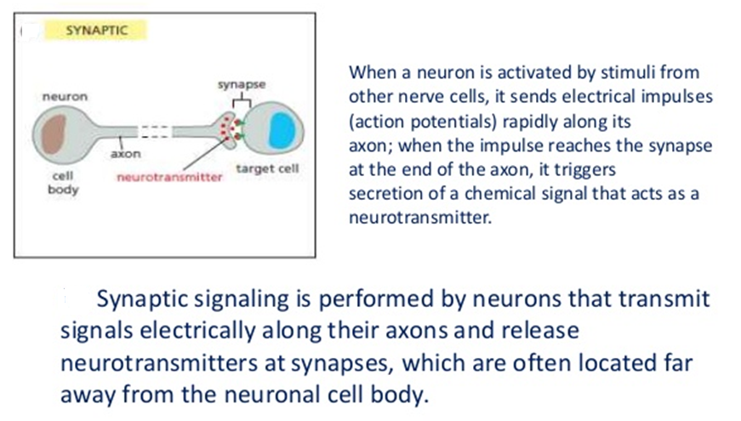
TYPES OF CELL SIGNALLING………
b) Synaptic cell signalling

Slide 15
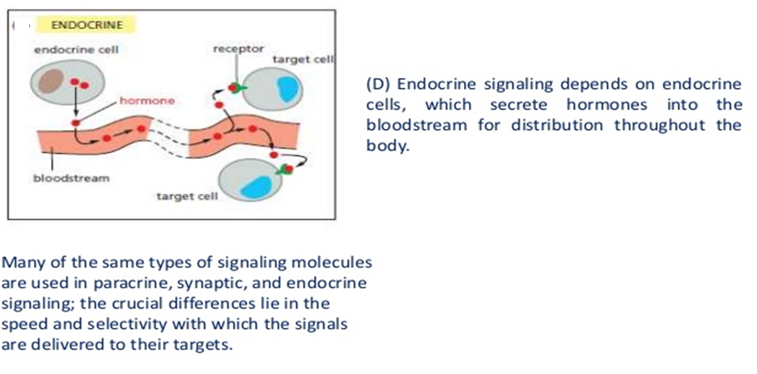
TYPES OF CELL SIGNALLING………
c) Endocrine cell signalling

Slide 16
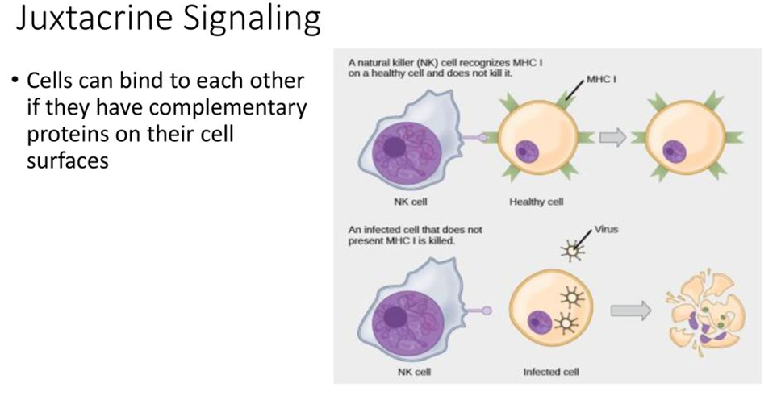
TYPES OF CELL SIGNALLING………

Slide 17
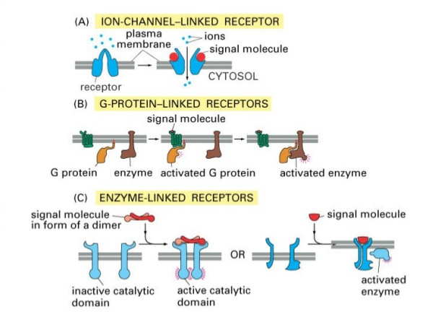
Cell-surface receptors
Cell-surface receptors, also known as transmembrane receptors, are proteins that are found attached to the cell membrane.
This type of receptor spans the plasma membrane and performs signal transduction, in which an extracellular signal is converted into an intercellular signal.
Ligands that interact with cell-surface receptors do not have to enter the cell that they affect.
Cell-surface receptors are also called cell-specific proteins or markers because they are specific to individual cell types.

Slide 18
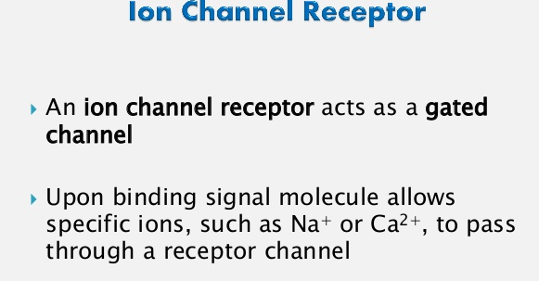
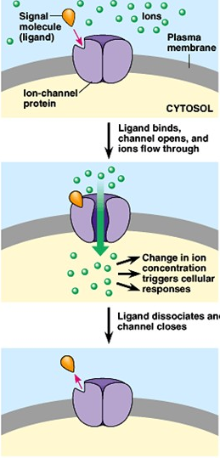

Slide 19
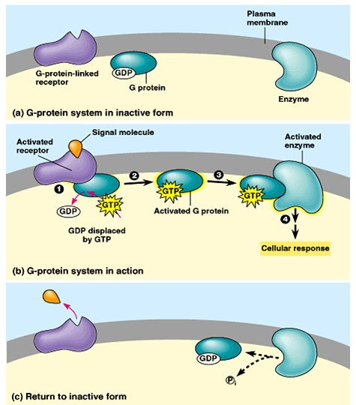
G-Protein Coupled Receptor (in other words, a membrane receptor that uses a G protein)
Step 1: -a ligand binds to the receptor and changes its shape-the receptor binds to a G protein-the G protein replaces GDP (like ADP) with GTP (like ATP), and the G protein is then activated.
Step 2: -the G protein binds to an enzyme and activates it -the enzyme triggers the next step leading to a cell response.
This activation of the G protein is temporary...to continue the response, new signal molecules are required.

Slide 20
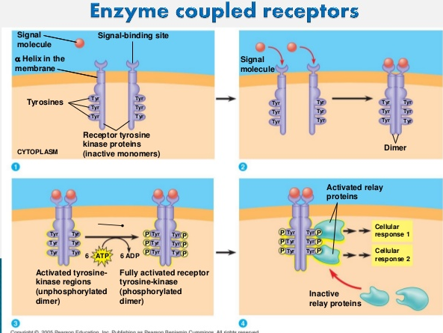
Enzyme-linked receptors or enzyme coupled receptors are cell-surface receptors with intracellular domains that are associated with an enzyme.
In some cases, the intracellular domain of the receptor itself is an enzyme. Other enzyme-linked receptors have a small intracellular domain that interacts directly with an enzyme.
When a ligand binds to the extracellular domain, a signal is transferred through the membrane, activating the enzyme.
Activation of the enzyme sets off a chain of events within the cell that eventually leads to a response.

Slide 21
Nervous system

Slide 22
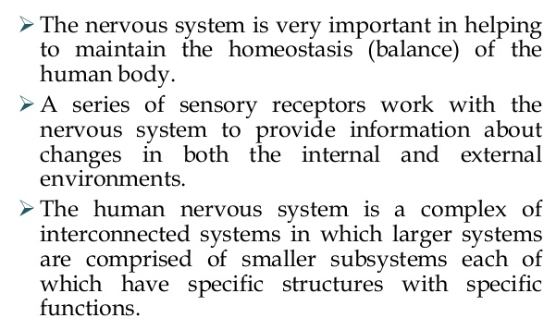
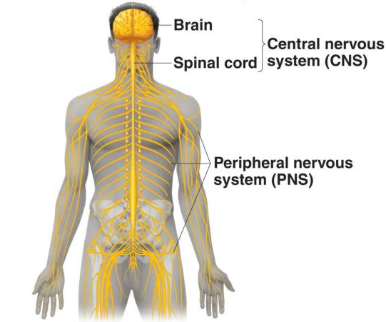
Nervous system

Slide 23
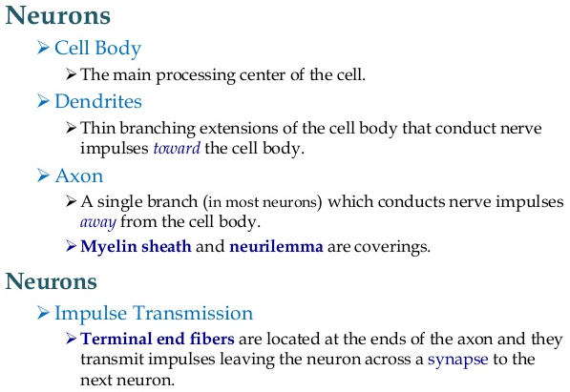
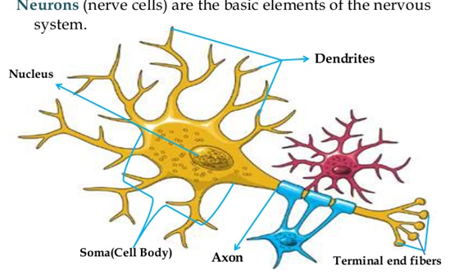

Slide 24
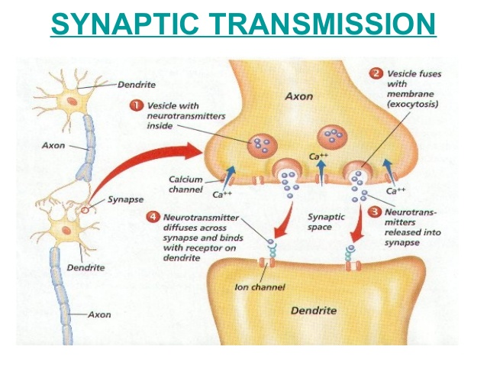

Slide 25
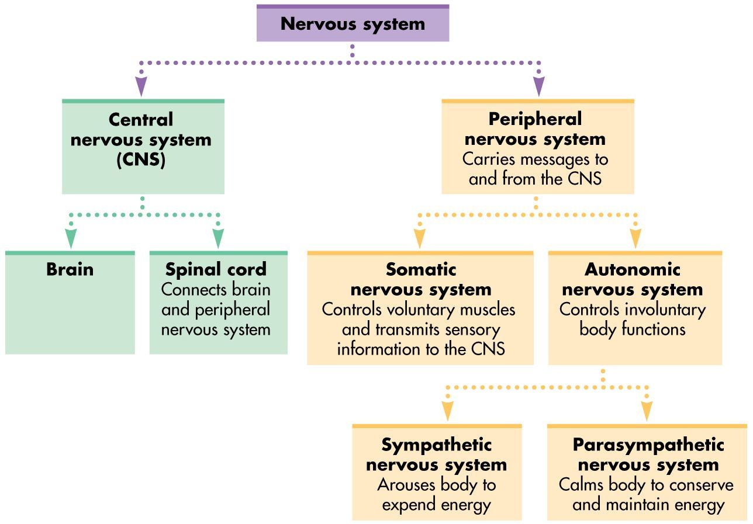

Slide 26
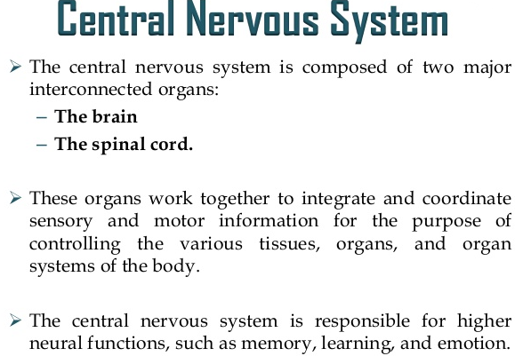
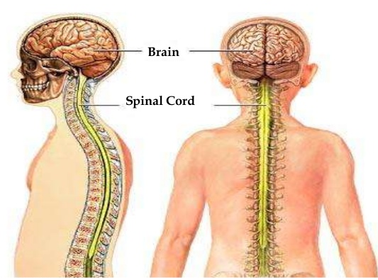

Slide 27
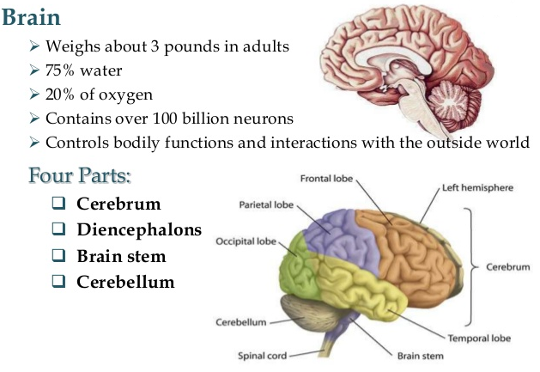

Slide 28
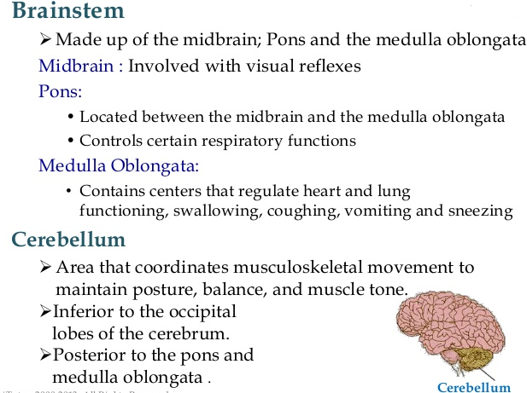

Slide 29
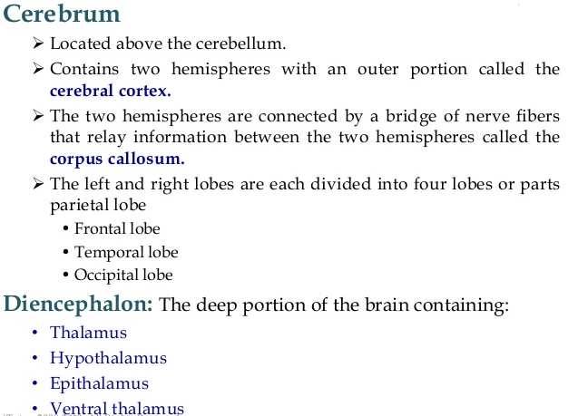

Slide 30
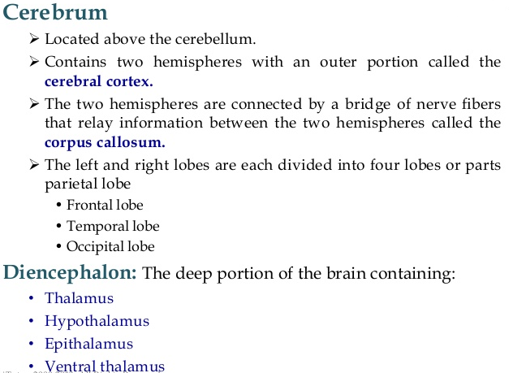

Slide 31
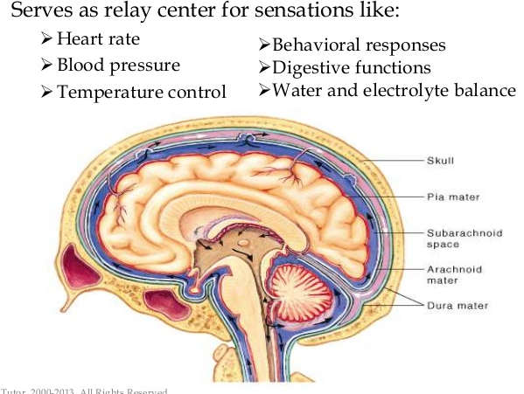

Slide 32
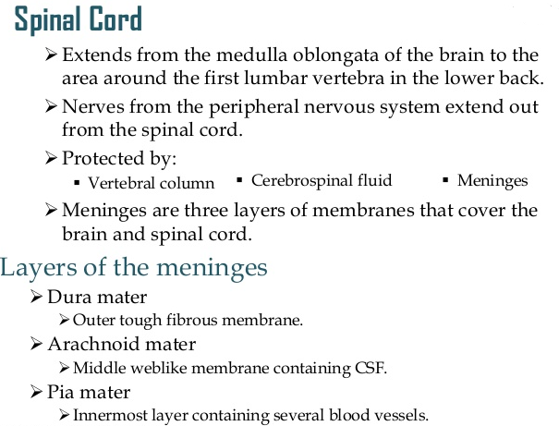

Slide 33
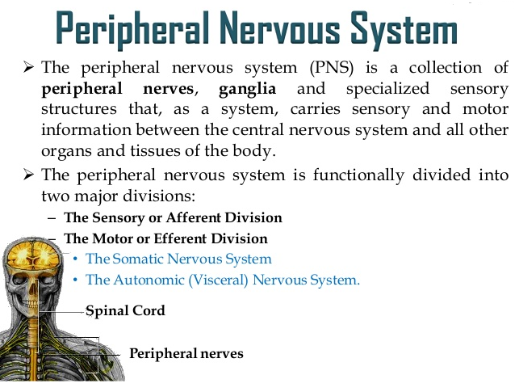

Slide 34
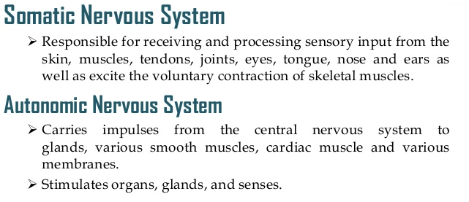

Slide 35
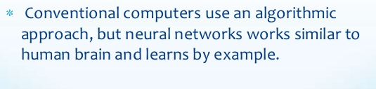
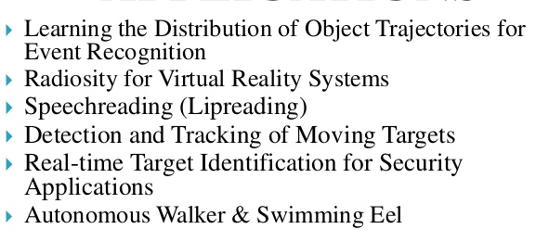
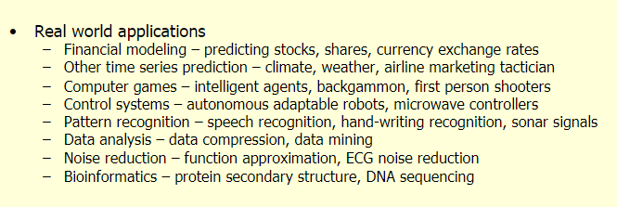
Application Of Neural Network

Slide 36
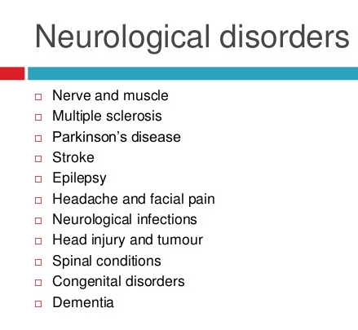

Slide 37
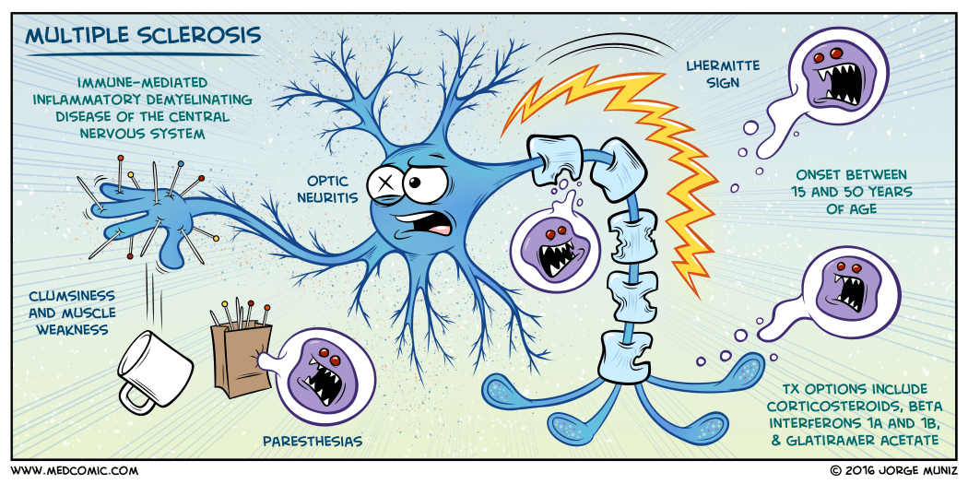
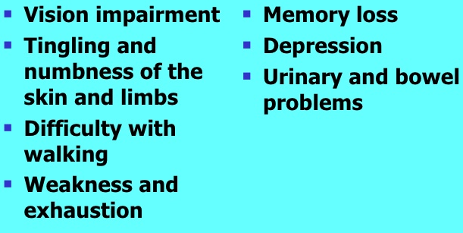
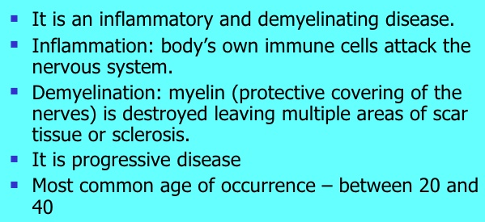
Multiple sclerosis
Signs and symptoms

Slide 38
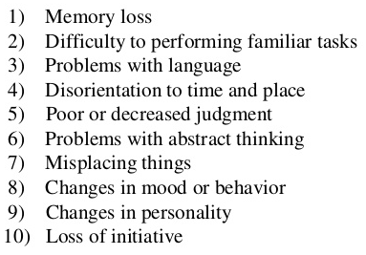
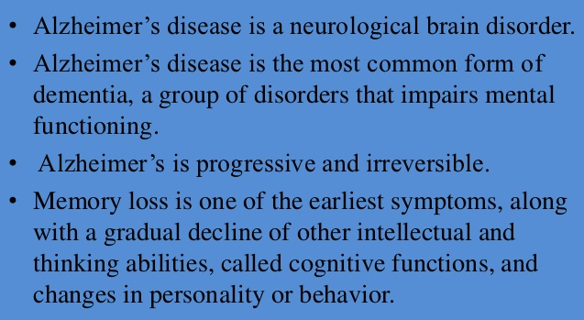
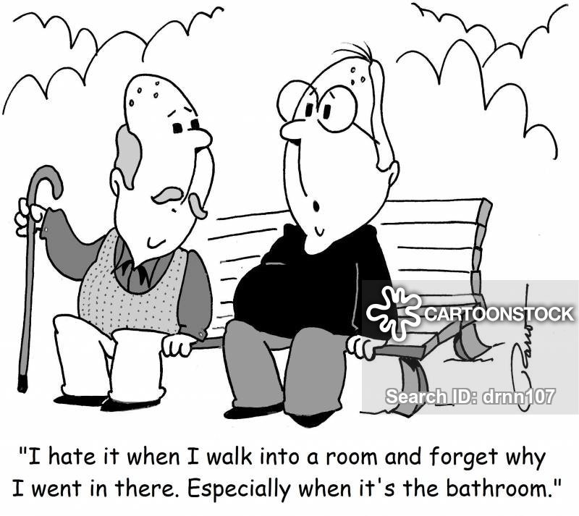
Alzheimer's disease
Signs and symptoms

Slide 39
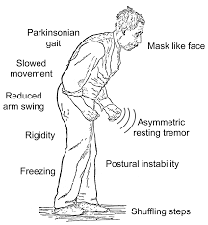
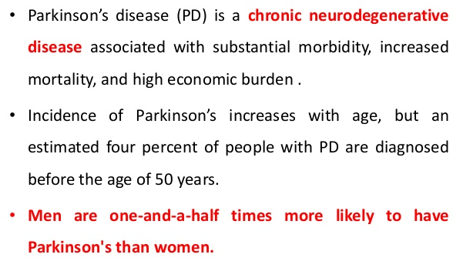
Parkinson’s disease
Signs and symptoms

Slide 40
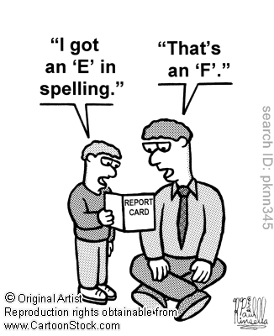
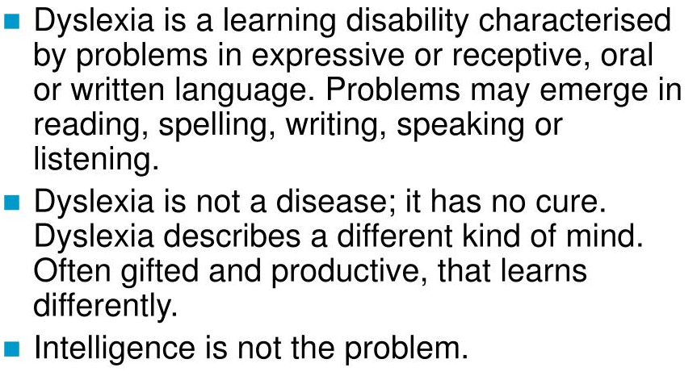
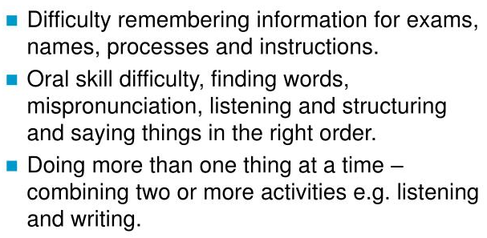
Dyslexia
Signs and symptoms

Slide 41



Narcolepsy
Signs and symptoms

Slide 42



Bipolar disorder

Slide 43
IMMUNE SYSTEM

Slide 44


Slide 45



Slide 46





Slide 47




Slide 48


Slide 49



Slide 50





Slide 51



Slide 52




Slide 53



Slide 54



Slide 55
Thank you

